Slide 1

B0646 Fundamentals of Management
Organizational Culture
and Structure
Notes:
V1.0
To change the footer on every slide:
1. On the menu go to Insert > Header and Footer…
2. Select the Footer checkbox and enter the footer text in the accompanying text box
3. Click “Apply to All”

Slide 2
“What’s your favorite movie?”
“Your favorite website?”
“What’s the last book you read for fun?”
“What makes you uncomfortable?”
These are the most frequently asked interview questions
These questions might not have much to do with your performance in previous jobs
Rather, they are designed to see whether you will fit in with the company’s culture, or organizational culture

Slide 3
Person-organization fit reflects the extent to which your personality and values match the climate and culture in an organization.
If being recognized for hard work is important to you, ask the interviewer how the company rewards performance.
If they answer “Well, we don’t really have a policy on that”
You’ll probably have a low person-organization fit and won’t be happy working there.

Slide 4
Recall that strategy consists of the large-scale action plans that reflect the organization’s vision and are used to set the direction for the organization.
To implement a particular strategy, managers must determine the right kind of organizational culture and organizational structure.

Slide 5
Organizational Culture
Organizational culture (corporate culture), is the set of shared, taken-for-granted implicit assumptions that a group holds and that determines how it perceives, thinks about, and reacts to its various environments.

Slide 6
Corporate culture includes
risk taking,
treatment of employees,
teamwork,
rules and regulations,
conflict and criticism,
Rewards
...
What drives an organization’s culture?
the values of the founder,
the industry and business environment,
the national culture,
the organization’s vision and strategies,
and the behavior of leaders.

Slide 7
Organizational Structure
Organizational structure is a system of reporting relationships
Organization’s members are coordinated and motivated by OS to achieve the organization’s goals.
The challenge - align the organization’s vision and strategies with its organizational culture and organizational structure.

Slide 8
Case - How Strategy Affects Culture & Culture Affects Structure: EndoStim, a Medical Device Start-up, Operates Virtually
Many people like the social interaction that comes with working in a physical office with other people.
Others welcome the opportunity to do task-oriented work in a makeshift home office, occasionally having to cope with loneliness and restlessness.
Which would you favor?
working in the company office with others
working alone at home
List five reasons for your choice

Slide 9
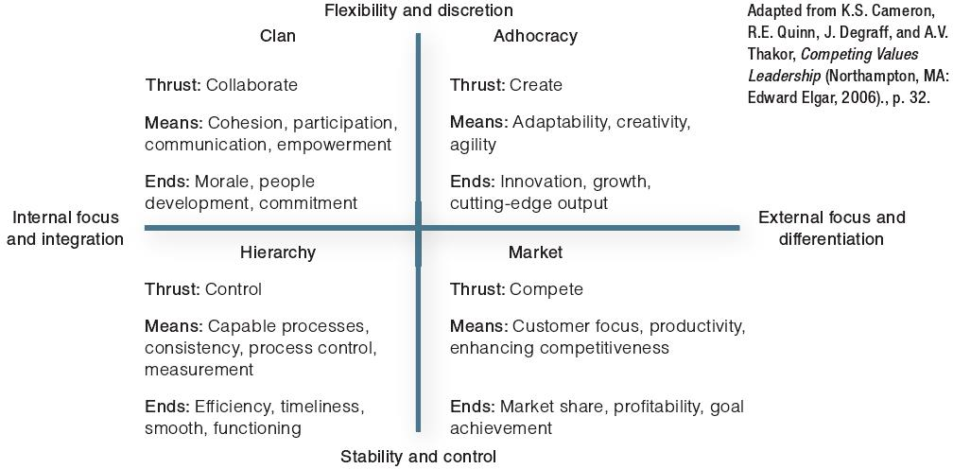
Types of Organizational Culture
Competing values framework

Slide 10
1. Clan Culture – family atmosphere
Internal focus and values flexibility.
Devote considerable resources to hiring and developing their employees, and view customers as partners.
Southwest Airlines is a good example of a company with a clan culture.
So is online shoe seller Zappos, which encourages managers to spend 10%–20% of their off-work hours with employees.

Slide 11
2. Adhocracy Culture – little structure
External focus and values flexibility.
Well suited for start-up companies, those in industries undergoing constant change, and in need of innovation to enhance growth.
EndoStim in the case is a good example of a company with an adhocrary culture.
So was Google once. In earlier times, all Google engineers were urged to spend 20% of their time on personal projects.

Slide 12
3. Market Culture – competition
External focus and values stability.
Employees are expected to work hard, react fast, and deliver quality work on time; performance-based reward.
Kia Motors, which fires executives who don’t meet their sales goals, is an example of a company with a very aggressive and competitive market culture.
So are some Wall Street firms, such as Citigroup.

Slide 13
4. Hierarchy Culture - control
Internal focus and values stability.
A drawback of such cultures is that they can lead to information “silos”, in which different divisions don’t share information.
Lots of big organizations, such as General Motors, UPS, and the U.S. Army, have a hierarchy culture.

Slide 14
Self-reflection question
Based on the above descriptions, what type of culture provides the best person-organization fit for you?
Why?

Slide 15
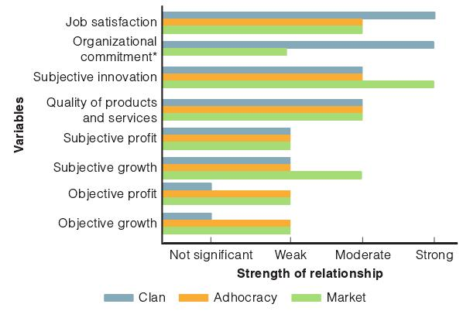
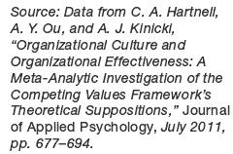

Slide 16
An organization’s culture matters.
Employees are happier with clan cultures.
Elements of these cultures can be used to boost innovation and quality.
Changing the organizational culture won’t necessarily boost financial performance (but it might).
Market cultures tend to produce better results.

Slide 17
Levels of Organizational Culture
Level 1 - Observable Artifacts
Physical manifestations such as manner of dress, awards, myths and stories about the company, rituals and ceremonies, and decorations, as well as visible behavior exhibited by managers and employees.
Example: In a conference room reserved for sensitive discussions, online travel company Kayak has a two-foot-high stuffed elephant named Annabelle—the “elephant in the room”—that is an artifact believed to bring forth more honest and constructive communications among employees (The expression “elephant in the room” is used in business and politics to mean an obvious truth that is either being ignored or going unaddressed.)

Slide 18
Level 2 - Espoused Values
The explicitly stated values and norms preferred by an organization, as may be put forth by the firm’s founder or top managers.
Example: The founders of technology company Hewlett-Packard stressed the “HP Way,” a collegial, egalitarian culture that gave as much authority and job security to employees as possible. Although managers may hope the values they espouse will directly influence employee behavior, employees don’t always “walk the talk,” frequently being more influenced by enacted values, which represent the values and norms actually exhibited in the organization.

Slide 19
Level 3 - Basic Assumptions
are not observable, represent the core values of an organization’s culture—those that are taken for granted and, as a result, are difficult to change.
Example: Many founders of start-ups hate rules and red tape. College Hunks Hauling Junk, for instance, was co-founded by Nick Friedman with no formal policies about dress code, vacation, sick days, and other things because he envisioned “a real-life Never Land where work is always fun, and the culture is always stress-free.” However, when the enterprise grew from a single cargo van to over 50 franchises, the freewheeling spirit made employees lose focus, and client service ratings, employee morale, and profitability all declined. The firm had to come up with rules and procedures while at the same time trying to “maintain a healthy balance of fun company culture with an accountable organization and team,” Friedman said.

Slide 20
Ways to learn organizational culture
1. Symbols: an object, act, quality, or event that conveys meaning to others.
2. Stories: a narrative based on true events, which is repeated and sometimes embellished upon to emphasize a particular value.
3. Heroes: a person whose accomplishments embody the values of the organization.
4. Rites & Rituals: the activities and ceremonies, planned and unplanned, that celebrate important occasions and accomplishments in the organization’s life.

Slide 21
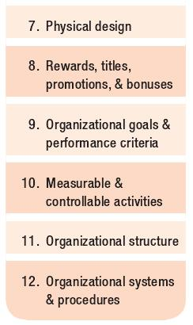
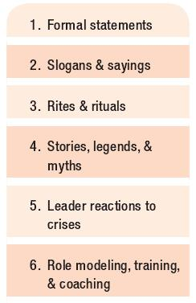
Ways to change organizational culture

Slide 22
Types of Organization
■ For-profit organizations. These are formed to make money, or profits, by offering products or services.
■ Nonprofit organizations. These are formed to offer services to some clients, not to make a profit (examples: hospitals, colleges).
■ Mutual-benefit organizations. These are voluntary collectives whose purpose is to advance members’ interests (examples: unions, trade associations).

Slide 23
Organization Chart
A box-and-lines illustration showing the formal lines of authority and the organization’s official positions or work specializations.
Two kinds of information that organization charts reveal
the vertical hierarchy of authority—who reports to whom
the horizontal specialization—who specializes in what work

Slide 24
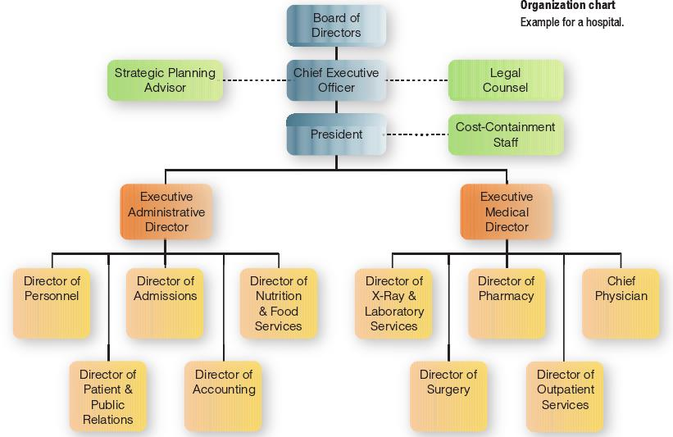

Slide 25
Common Organizational Elements
1. Common Purpose: unifies employees or members and gives everyone an understanding of the organization’s reason for being.
2. Coordinated Effort: the coordination of individual efforts into a group or organization-wide effort to realize the common purpose.
3. Division of Labor: also known as work specialization, is the arrangement of having discrete parts of a task done by different people.
4. Hierarchy of Authority: or chain of command, is a control mechanism for making sure the right people do the right things at the right time.
A flat organization: an organizational structure with few or no levels of middle management between top managers and those reporting to them.
Unity of command: an employee should report to no more than one manager

Slide 26
Span of Control
The span of control, or span of management, refers to the number of people reporting directly to a given manager.
Narrow Span of Control: This means a manager has a limited number of people reporting
e.g., three vice presidents reporting to a president, instead of nine vice presidents.
An organization is said to be tall when there are many levels with narrow spans of control.
Wide Span of Control: This means a manager has several people reporting
e.g., a first-line supervisor may have 40 or more subordinates
An organization is said to be flat when there are only a few levels with wide spans of control.

Slide 27
The trend of span of control
Spans of about 7 to 10 subordinates were considered best, but there is no consensus as to what is ideal.
In general, when managers must be closely involved with their subordinates, as when the management duties are complex, they are advised to have a narrow span of control.
This is why presidents tend to have only a handful of vice presidents reporting to them.
By contrast, first-line supervisors directing subordinates with similar work tasks may have a wide span of control.

Slide 28
Today’s lean management staffs and more efficiency means that spans of control need to be as wide as possible while still providing adequate supervision.
Wide spans also allow workers greater autonomy in decision making.

Slide 29
Authority
Authority refers to the rights inherent in a managerial position to make decisions, give orders, and utilize resources.
Authority means accountability—managers must report and justify work results to the managers above them.
Being accountable means you have the responsibility for performing assigned tasks.
Responsibility is the obligation you have to perform the tasks assigned to you.
Delegation is the process of assigning managerial authority and responsibility to managers and employees lower in the hierarchy.

Slide 30
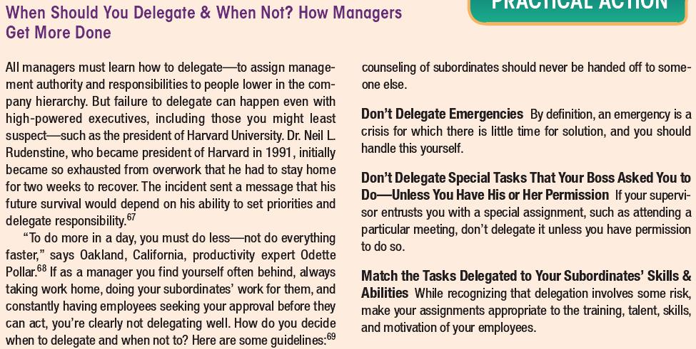
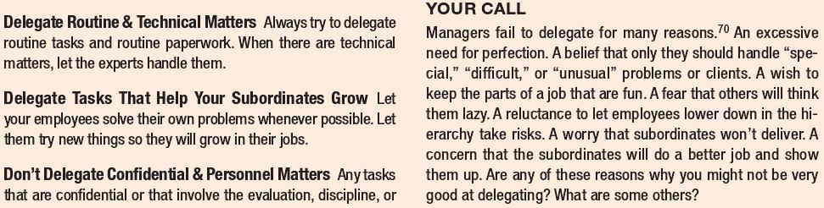

Slide 31
Centralization versus Decentralization
Centralized authority: important decisions are made by higher-level managers.
Very small companies tend to be the most centralized, although nearly all organizations have at least some authority concentrated at the top of the hierarchy.
Kmart and McDonald’s.
Advantage: less duplication of work; procedures are uniform and thus easier to control
Decentralized authority: important decisions are made by middle-level and supervisory-level managers.
Power has been delegated throughout the organization.
General Motors and Harley-Davidson.
Advantage: decisions are made more quickly, which increases the organization’s flexibility and efficiency.

Slide 32
Organizational Structure
Organizational design is concerned with designing the optimal structures of accountability and responsibility that an organization uses to execute its strategies.
We may categorize organizational designs as three types:
(1) Traditional designs
The simple structure
The functional structure
The divisional structure
Product division
Customer division
Geographic division
Matrix structure
(2) Horizontal designs
(3) Open boundary designs
Hollow structure
Modular structure
Virtual structure

Slide 33
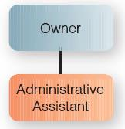
Traditional Designs
The Simple Structure: For the Small Firm
A simple structure has authority centralized in a single person, a flat hierarchy, few rules, and low work specialization.

Slide 34
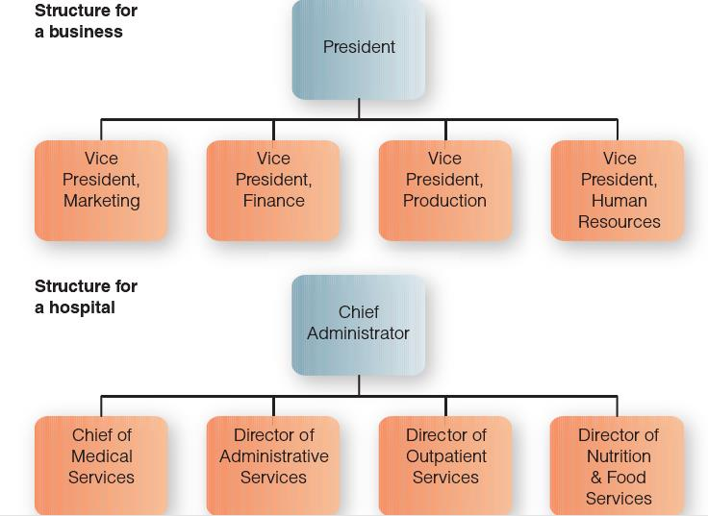
The Functional Structure: Grouping by Similar Work Specialties
In a functional structure, people with similar occupational specialties are put together in formal groups.
This is a quite commonplace structure, seen in all kinds of organizations

Slide 35
The Divisional Structure: Grouping by Similarity of Purpose
In a divisional structure, people with diverse occupational specialties are put together in formal groups by similar products or services, customers or clients, or geographic regions.
Product divisions group activities around similar products or services.
Examples: The media giant Time Warner.
Customer divisions tend to group activities around common customers or clients.
Examples: Ford Motor.
Geographic divisions group activities around defined regional locations.
Example: The Federal Reserve Bank

Slide 36
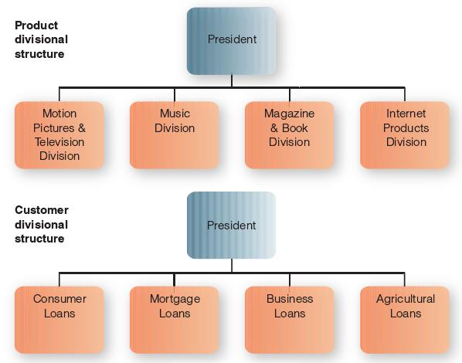
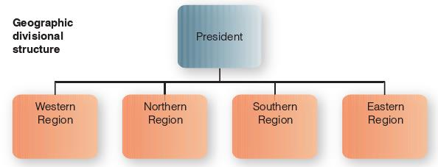

Slide 37
The Matrix Structure: A Grid of Functional & Divisional Structure
In a matrix structure, an organization combines functional and divisional chains of command in a grid so that there are two command structures—vertical and horizontal.
The functional structure usually doesn’t change, such as Finance, Marketing, Production, and Research & Development.
The divisional structure may vary—as by product/brand, customer, or geographic region.

Slide 38
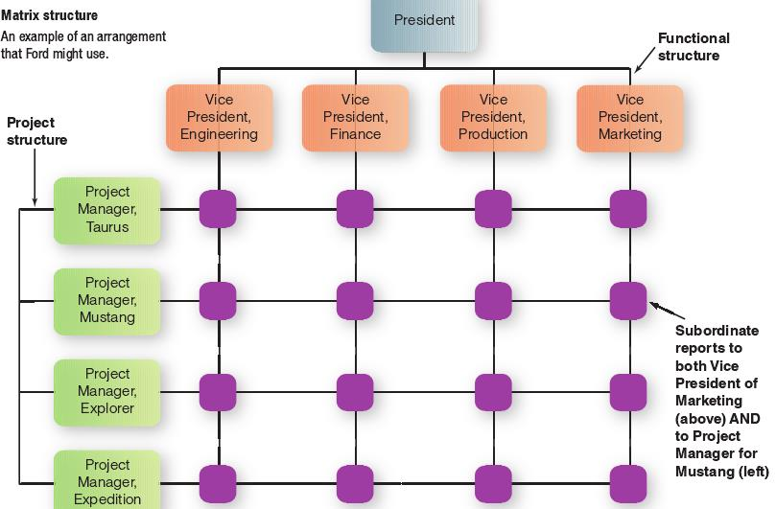

Slide 39
The Horizontal Design
A team-based design, or cross-functional teams or workgroups, are used to improve collaboration and work on shared tasks by breaking down internal boundaries.
Team members still have their full-time functional work responsibilities and often still formally report to their own managers above them in the functional-division hierarchy.

Slide 40
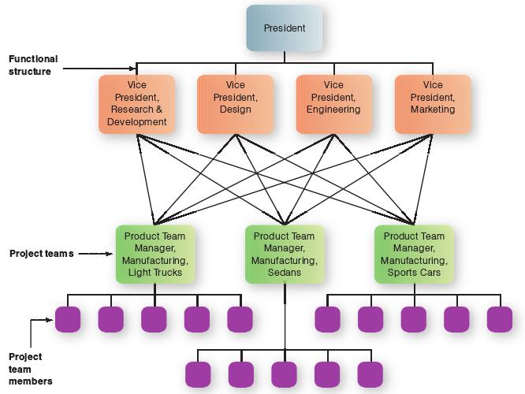

Slide 41
Open Boundary Designs
A boundary-less organization is a fluid, highly adaptive organization whose members, linked by information technology, come together to collaborate on common tasks.
The collaborators may include not only coworkers but also suppliers, customers, and even competitors.

Slide 42
The Hollow/Network Structure: Operating with a Central Core & Outsourcing Functions to Outside Vendors
A company with a hollow structure might retain important core processes as design or marketing and outsource most other processes, such as human resources, warehousing, or distribution, thereby seeming to “hollow out” the organization.

Slide 43
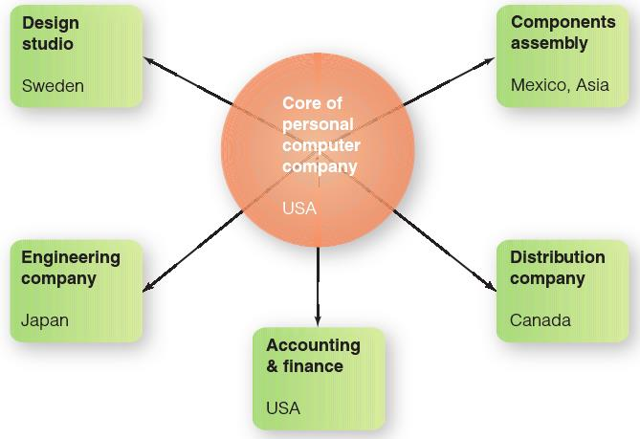

Slide 44
The Modular Structure: Outsourcing Pieces of a Product to Outside Firms
Differs from the hollow structure in that it is outsourcing certain pieces of a product rather than outsourcing processes (such as human resources or warehousing) of an organization.
A firm assembles product chunks, or modules, provided by outside contractors.

Slide 45
For example, Bombardier, of Wichita, Kansas, makes eight-passenger business jets – the Continental, that is designed in large modules that are built in various places.
The cockpit and forward fuselage are built by Bombardier Montreal.
The center section is built in Belfast,
the wing by Mitsubishi in Japan,
the stabilizers and rear fuselage by Aerospace Industrial Development in Taiwan,
the landing gear by Messier-Dowty in Canada,
the tailcone by Hawker de Havilland in Australia,
The engines are provided by General Electric and the avionics gear by Rockwell Collins, both companies in the United States.
The 12 modules are shipped to Wichita, where the parts are snapped together in just four days.

Slide 46
The Virtual Structure: An Internet-Connected Partner for a Temporary Project
An organization whose members are geographically apart, usually working with e-mail, collaborative computing, and other computer connections.
A company outside the company is created specifically to respond to an exceptional market opportunity that is often temporary.
e.g., Nokia, which had trouble gaining market share in the US, changed its strategy to develop phones in partnership with U.S. carriers, as by assigning product developers to AT&T and Verizon.

Slide 47
Practice
Draw the organizational structures of TWO organizations.
You should use two types of the following:
(1) Traditional designs
The simple structure
The functional structure
The divisional structure
Product division
Customer division
Geographic division
Matrix structure
(2) Horizontal designs
(3) Open boundary designs
Hollow structure
Modular structure
Virtual structure

Slide 48
Mechanistic versus Organic Organizations
Mechanistic Organizations: When Rigidity & Uniformity Work Best
In a mechanistic organization, authority is centralized, tasks and rules are clearly specified, and employees are closely supervised.
Mechanistic organizations, then, are bureaucratic, with rigid rules and top-down communication.
This kind of structure is effective in certain aspects of hotel work because the market demands uniform product quality and cleanliness.

Slide 49
Organic Organizations: When Looseness & Flexibility Work Best
In an organic organization, authority is decentralized, there are fewer rules and procedures, and networks of employees are encouraged to cooperate and respond quickly to unexpected tasks.
Organic organizations are sometimes termed “adhocracies” because they operate on an ad hoc basis.

Slide 50
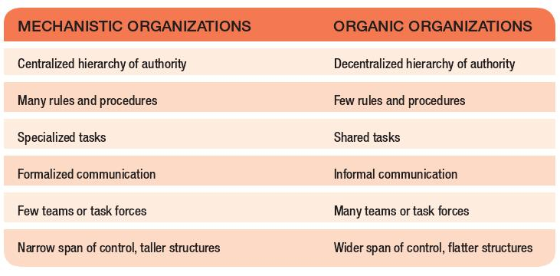

Slide 51
Differentiation versus Integration
Differentiation: When Forces Push the Organization Apart
Differentiation is the tendency of the parts of an organization to disperse and fragment.
For example, a company producing dental floss, deodorants, and other personal-care products might have different product divisions, each with its own production facility and sales staff—a quite differentiated organization.
Integration: When Forces Pull the Organization Together
Integration is the tendency of the parts of an organization to draw together to achieve a common purpose.

Slide 52
Review case - IDEO’s Culture Reinforces Helping Behavior
Read the case and finish the following questions individually:
1. Using the competing values framework as a point of reference, how would you describe the current organizational culture at IDEO? Provide examples to support your conclusions.
2. What type of culture is desired by Tim Brown to meet his goals? Does the company have this type of culture? Discuss.
3. Which of the 12 ways to embed organizational culture has IDEO used to create its current culture? Provide examples to support your conclusions.
4. Does Tim Brown want to create more of a mechanistic or organic organization? Explain the rationale for his preference.
5. What is the most important lesson from this case? Discuss.

